Slide 1

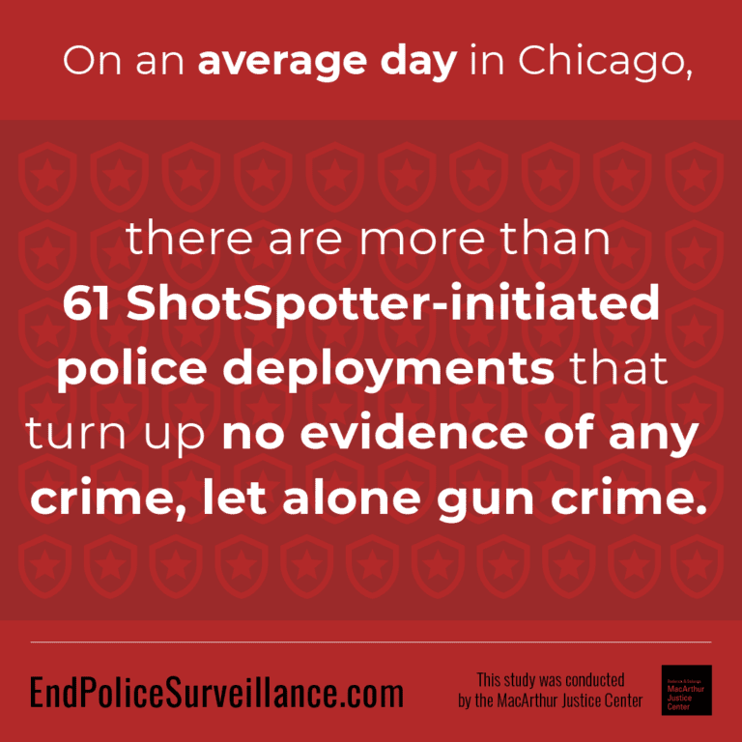
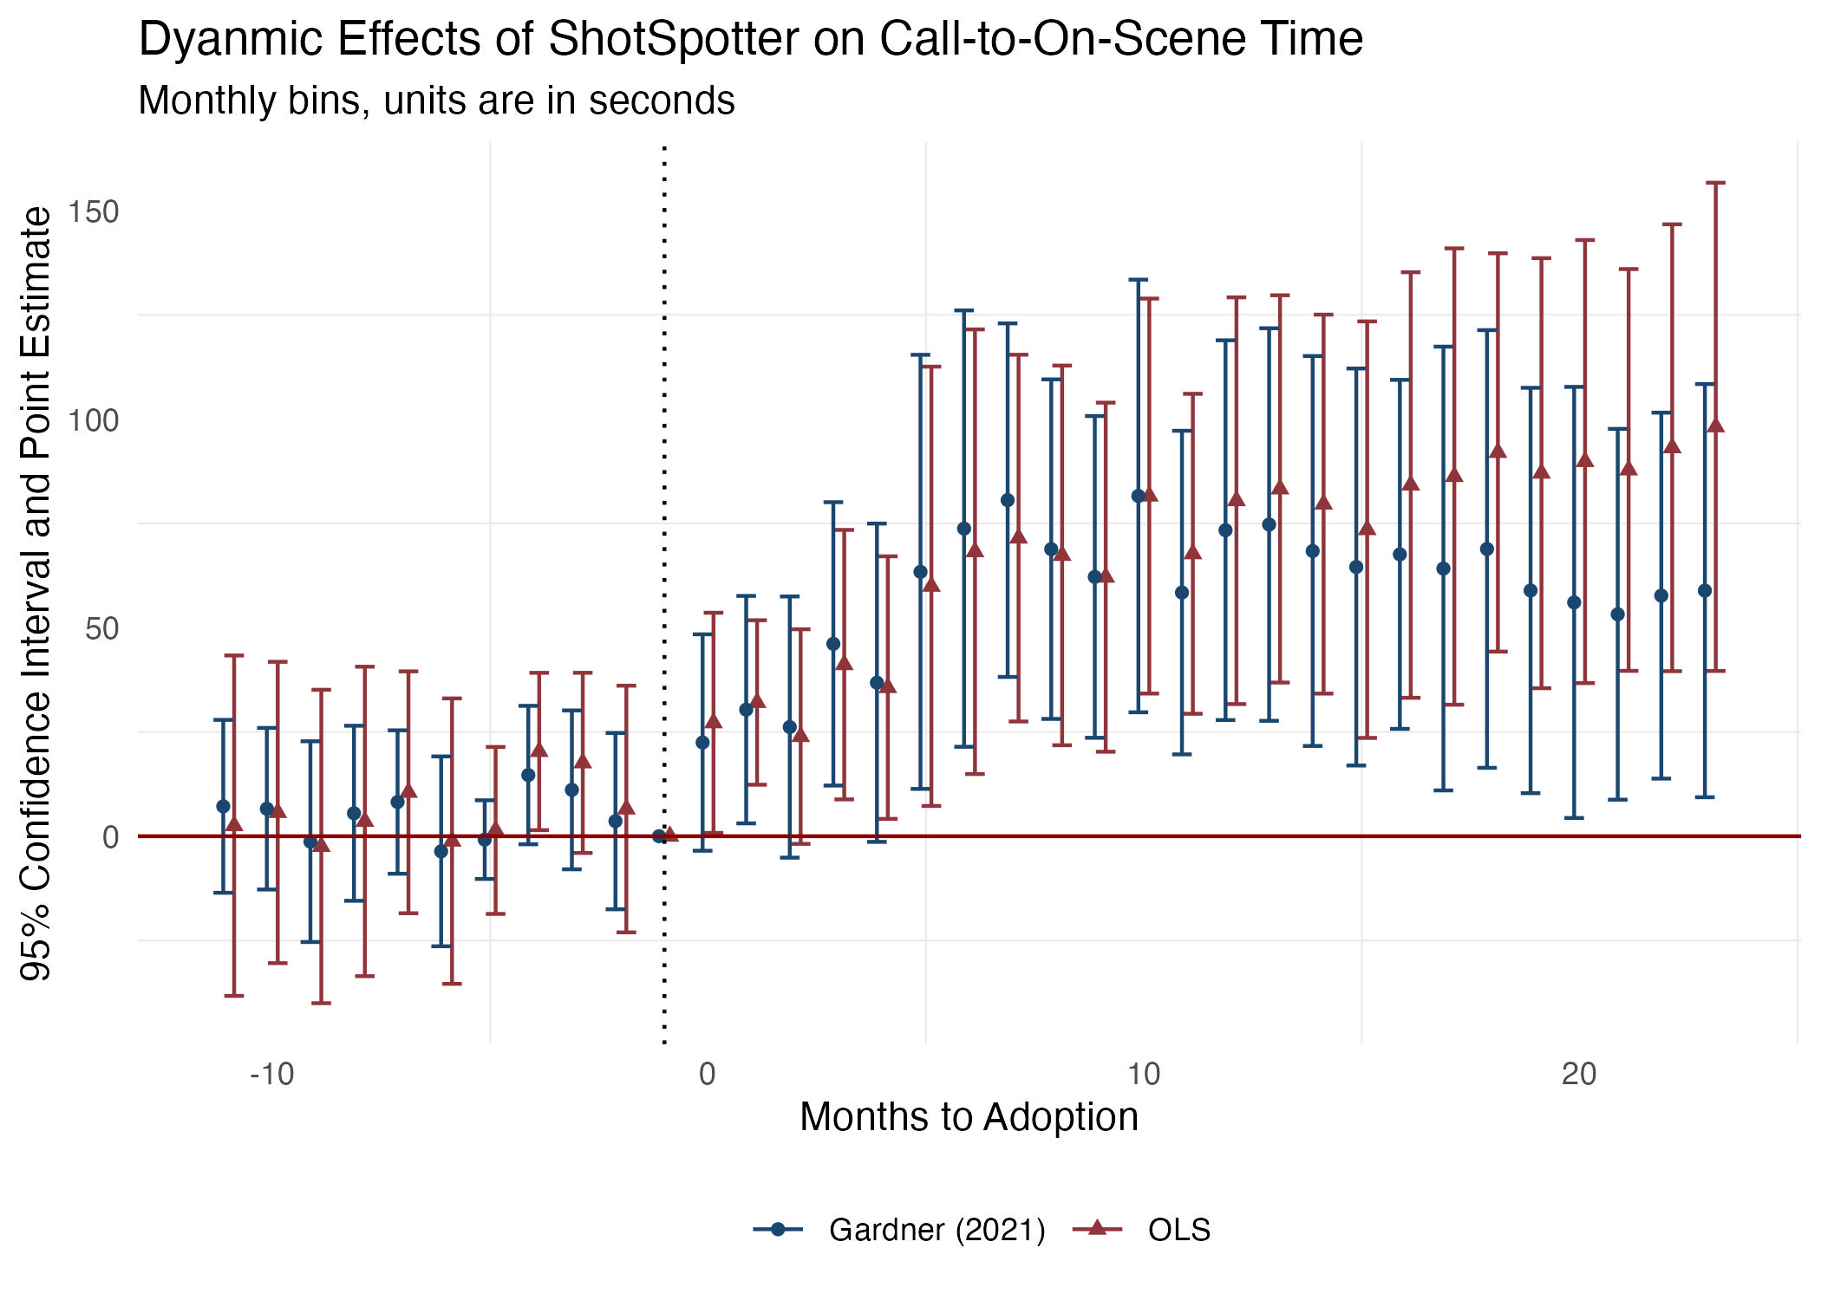
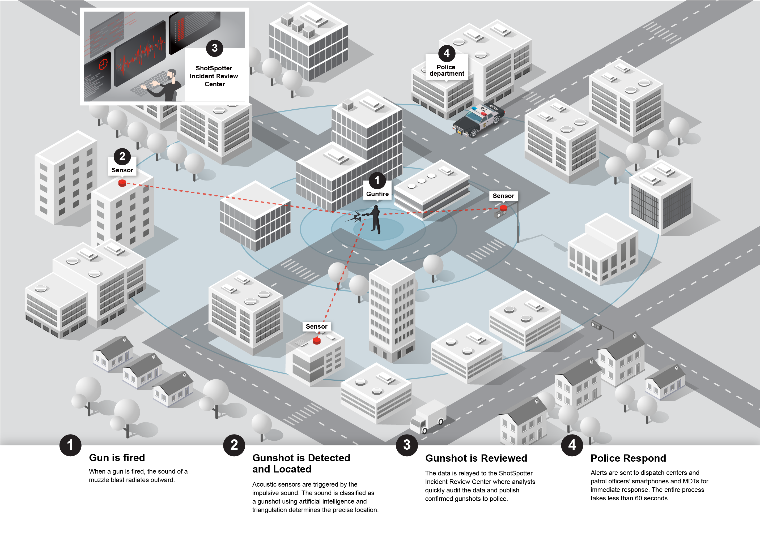
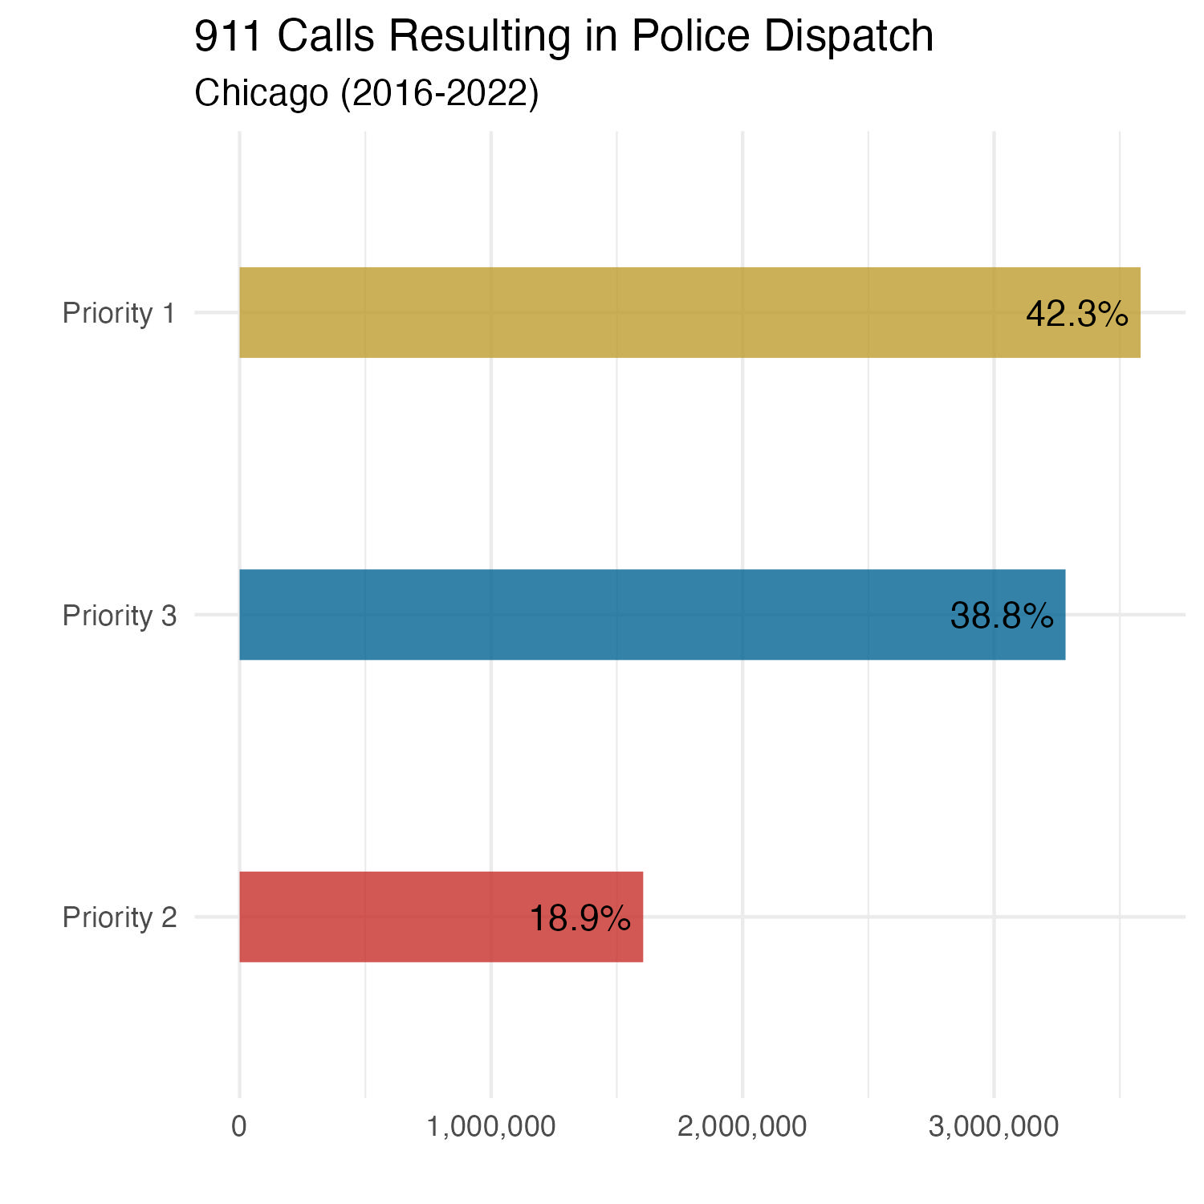
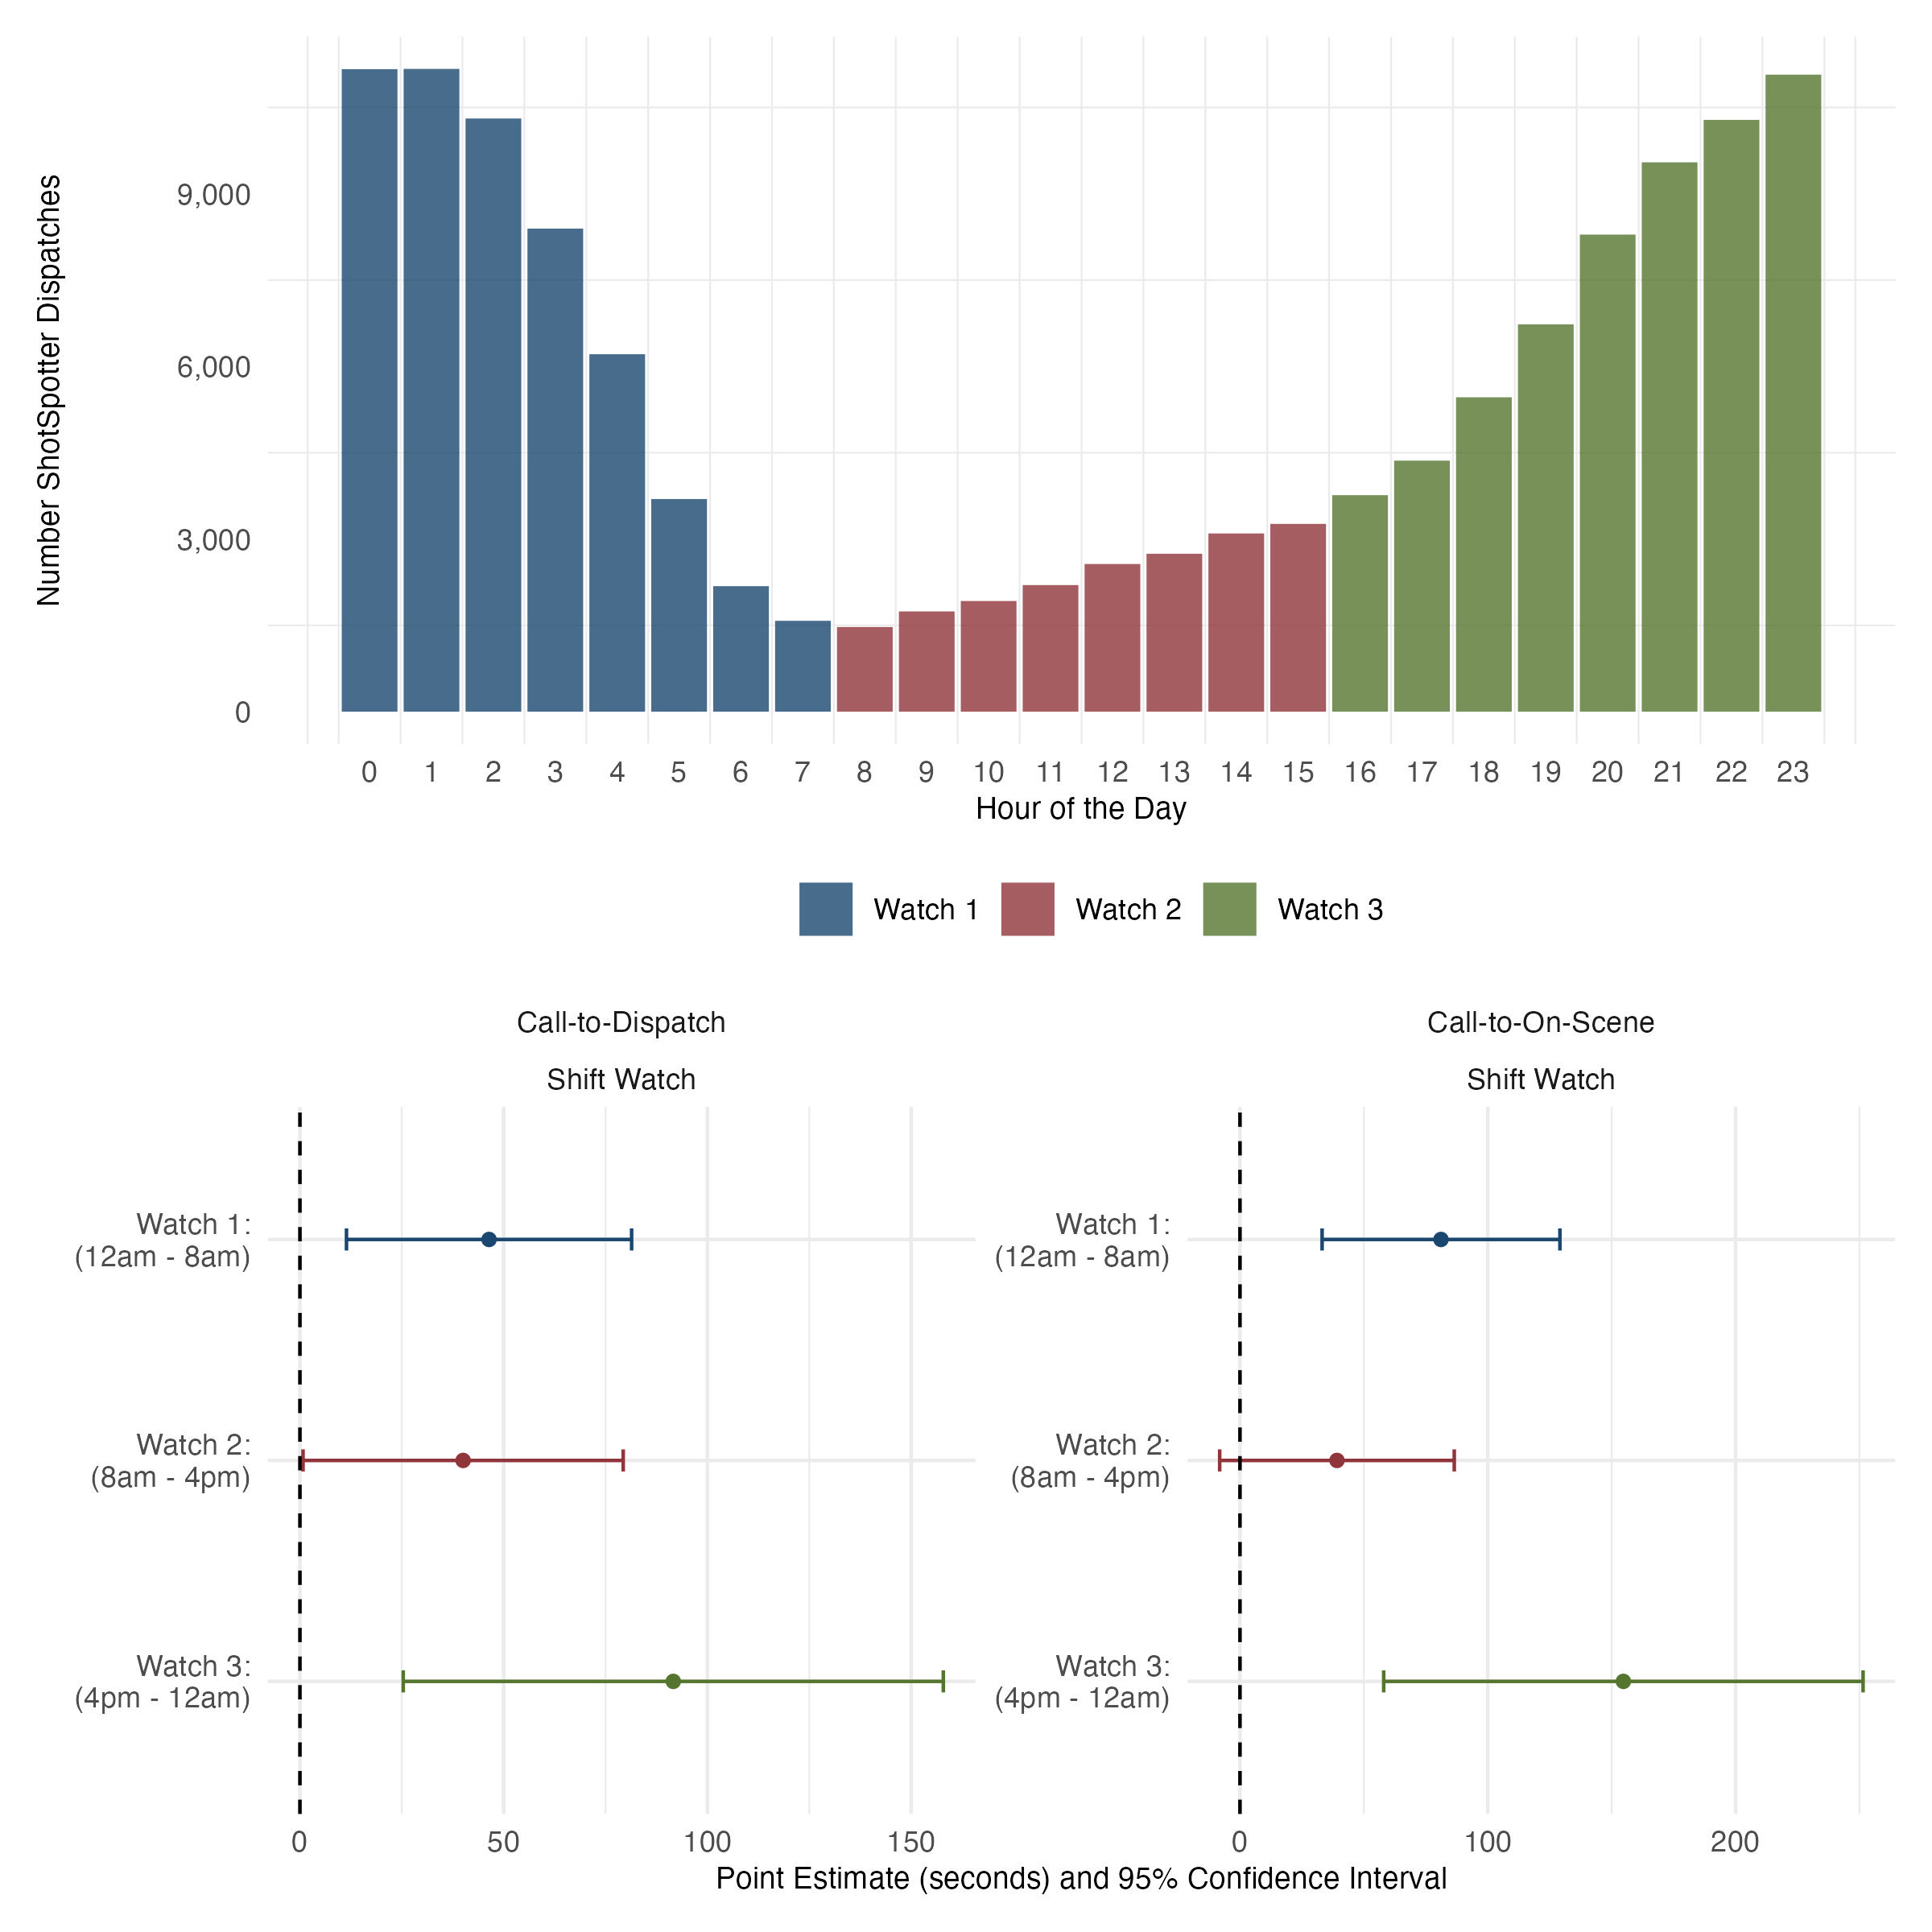
ShotSpotter technology is in 150+ cities world-wide to mitigate gun violence. We find unintended consequences.
Dispatchers take +1 min to find available officer, officers take +2 to arrive on-scene. Results in lower probability of arrest.
The Effect of ShotSpotter Technology on Police Response Times
Setting: Chicago
Method: Staggered D-in-D
We use a comprehensive data set of Priority 1 911 call dispatches over 2016-2022. Merge with shifts, arrests, victimizations.
ShotSpotter incapacitates officers from attending to 911 calls by constraining officer time. Driven by times with fewer officers.
Michael Topper and Toshio Ferrazares
Data: Priority 1 911 Call Dispatches
More ShotSpotter alerts results in larger effects
Source: Soundthinking website https://www.soundthinking.com/law-enforcement/gunshot-detection-technology/

